Slide 1
Mantid Release Presentation
Release 3.2
ISIS

Slide 2
What is this meeting
Release 3.1
Release planned Friday 7th February
Present the changes and improvements
No focus this time
What’s coming next

Slide 3



What we targeted for v3.1
ISIS
Live event data reduction
Logs
Multi Period
Automatic Reduction
Expansion to more instruments
Upload to ICAT
Training courses
More sessions
ISIS & ORNL
Recording
ICAT 4 Multi facility support
Various technique led improvements

Slide 4
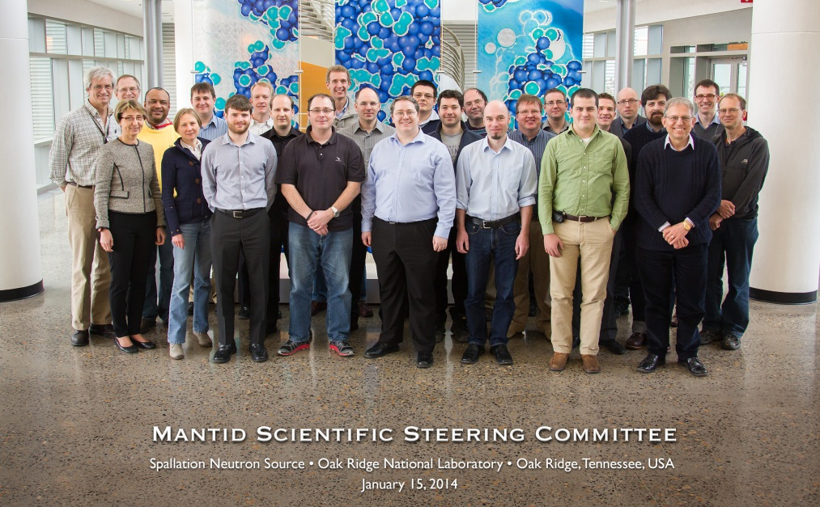
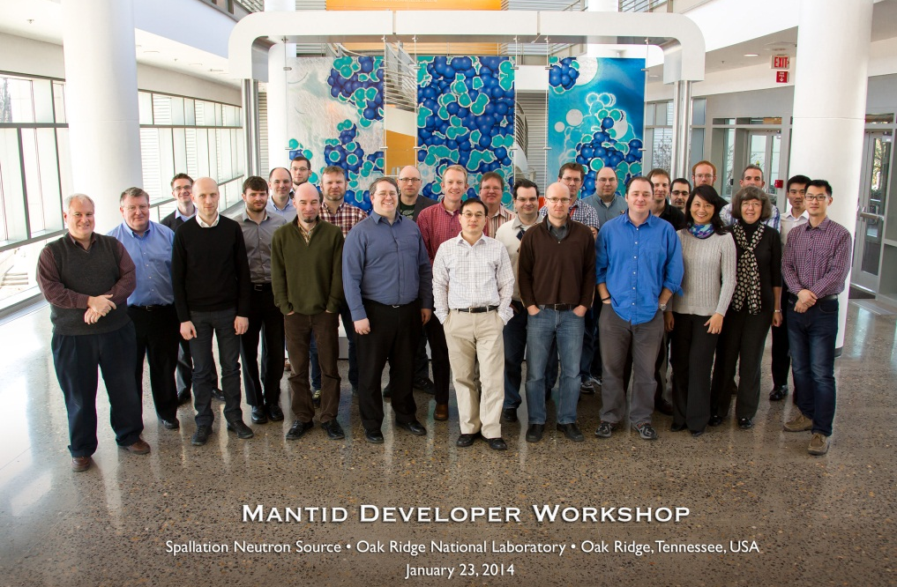
Cross facility meetings
Scientific Steering Committee
Developer Workshop

Slide 5
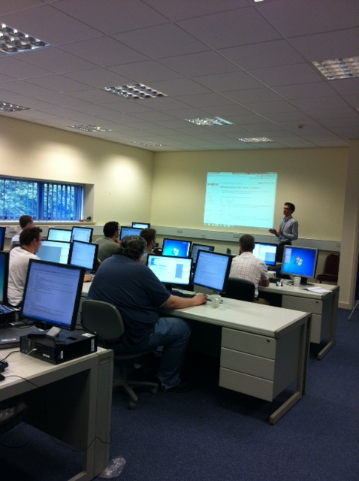
Training Courses
Dates
8-10th January
14-17th January (ORNL)
Neutron Training Course
Next run April-May
To Book
Email: nick.draper@stfc.ac.uk
More details at www.mantidproject.org

Slide 6
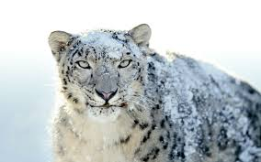


Supported Platforms
Staying the same
RHEL 6 64bit
Windows 7 64 bit
Ubuntu LTS 64 bit
Changed this release
OSX Mountain Lion +
Last supporting release
Windows XP 32bit

Slide 7
User Interface

Slide 8
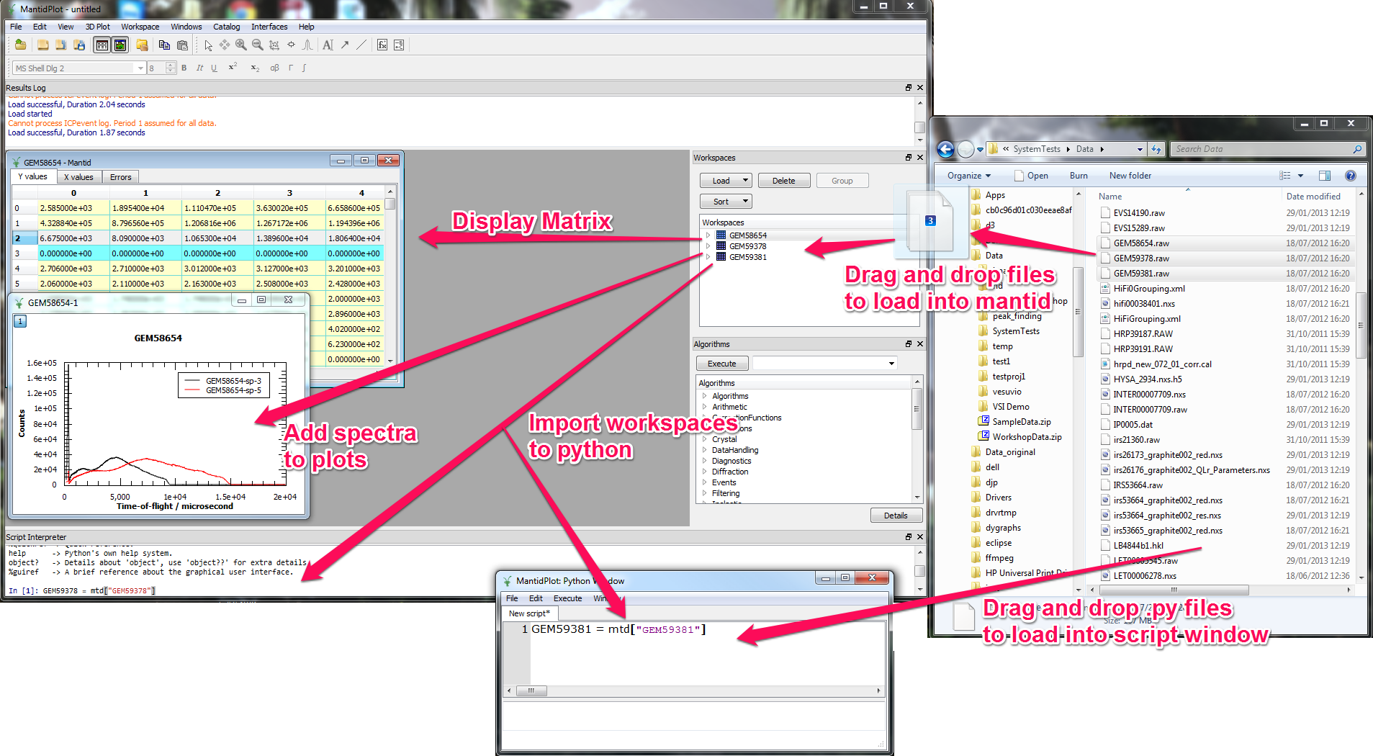
User Interface
Drag and drop

Slide 9
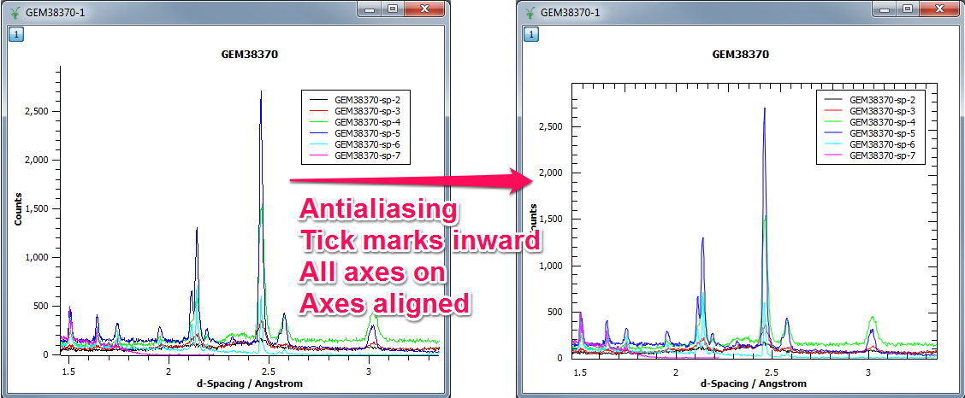
User Interface
Plotting Improvements

Slide 10
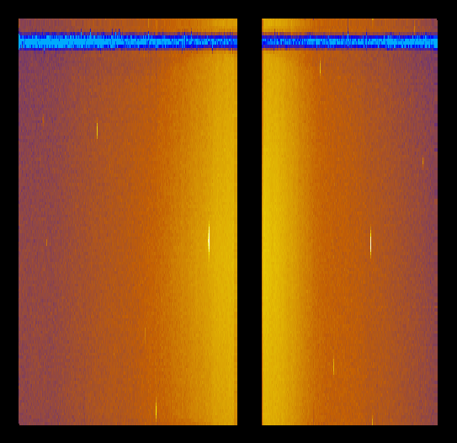
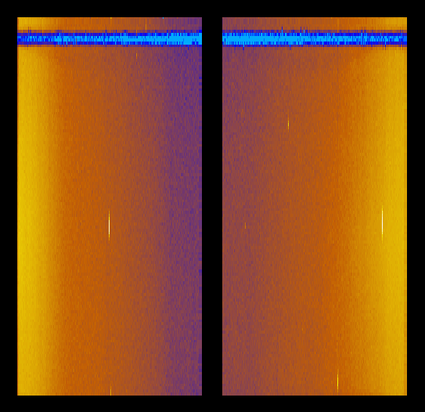
Instrument View
Unwrapped view selects the starting point on the horizontal
axis automatically
WISH 9 panels
WISH 10 panels

Slide 11
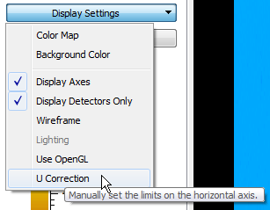
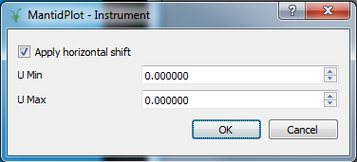
Instrument View
New Display Setting option controls the limits on the
horizontal (U) axis
Tick to apply manual correction
Un-tick to let instrument view
to set limits automatically
Same values for both limits: calculate U Max to see
all of the instrument

Slide 12
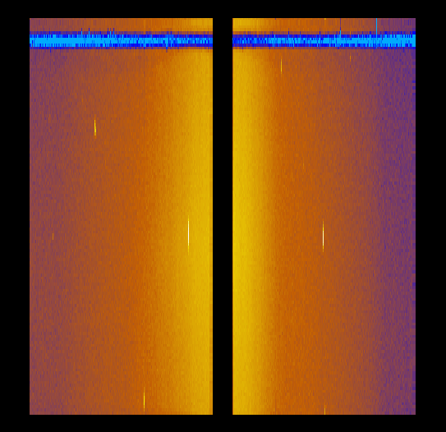
Instrument View
After setting U Min manually for 10 panel WISH view
WISH 9 panels
(automatic)
WISH 10 panels
(manual)

Slide 13
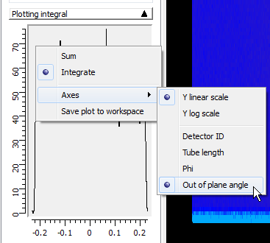
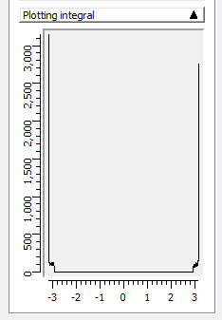
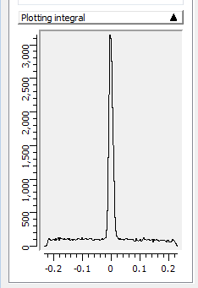
Instrument View
Out-of-plane angle units are added to the mini-plot
A WISH panel08 tube
Phi
Out of plane angle

Slide 14

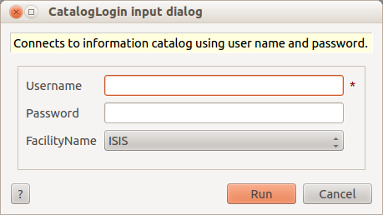
Catalog features
Paging in catalog search
Faster responses from the catalog
100 results returned at a time
Catalog facility login
Uses the facility’s catalog info
Currently supports 1 facility
Several GUI improvements
Search by investigation id
Better tooltips (e.g. run-range)
Show/hide catalog menu items if logged in
Default instrument in catalog search

Slide 15
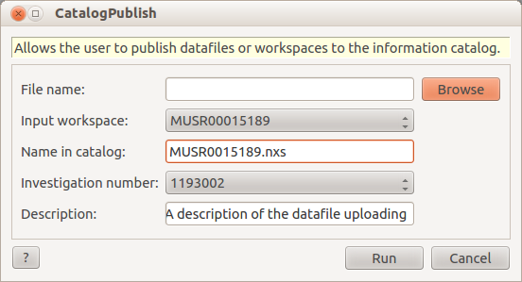
Catalog publishing
New catalog algorithm
Publish datafiles or workspaces directly to the archives.
You must have investigations in order to publish
Data published is:
Automatically private
Searchable from the catalog interface
Catalog publish interface
Auto populated inves id field
GUI disabled if no “my data”

Slide 16
DEMO

Slide 17
Framework

Slide 18
Framework
Memory Issues
Memory was not being released properly with certain sequences of operations
Very slow deletion of large histogram workspaces on Windows
Live Data
Fixed problems with streaming ISIS event data
Now handles multi-period data

Slide 19
Framework – New Algorithms
CalculateGammaBackground
CatalogPublish
ConvertSnsRoiFileToMask
ConvertToYSpace
CorrectLogTimes
CreateTransmissionWorkspace
CreateTransmissionWorkspaceAuto
DensityOfStates
FilterLogByTime
GetEiT0atSNS
IndirectTransmission
LoadPDCharacterizations
MaskAngle
MaskBTP
MuonCalculateAsymmetry
MuonGroupDetectors
MuonLoad
NormaliseByPeakArea
OptimizeLatticeForCellType
PerformIndexOperations
RefinePowderDiffProfileSeq
ReflectometryReductionOne
ReflectometryReductionOneAuto
SortDetectors

Slide 20
Framework
Autoreduction
New hardware bought to support indirect inelastic beamlines
Any other groups interested please do not hesitate to let us know
LoadFullprofResolution
Now supports: translation of Fullprof Ikeda-Carpenter pseudo-Voigt resolution file into Mantid equivalent
And translation of Fullprof back-to-back exp pseudo-Voigt resolution file into Mantid back-to-back exp gaussian

Slide 21
Indirect Inelastic

Slide 22
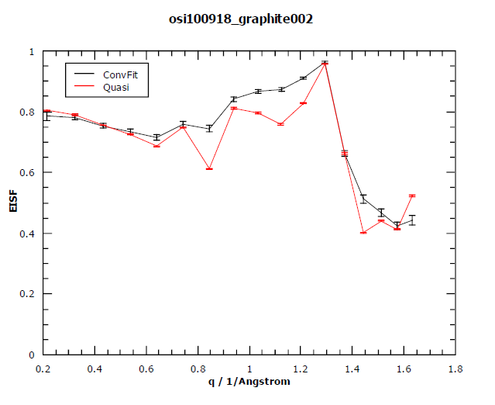
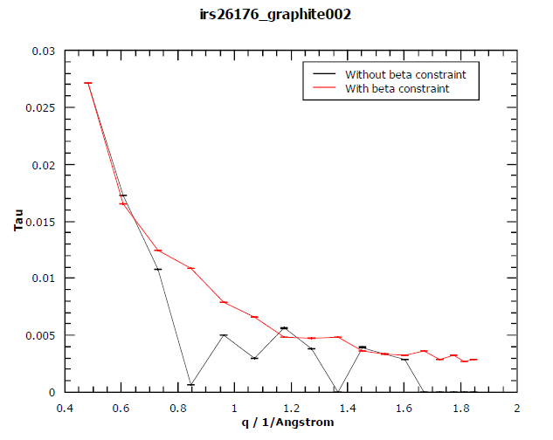
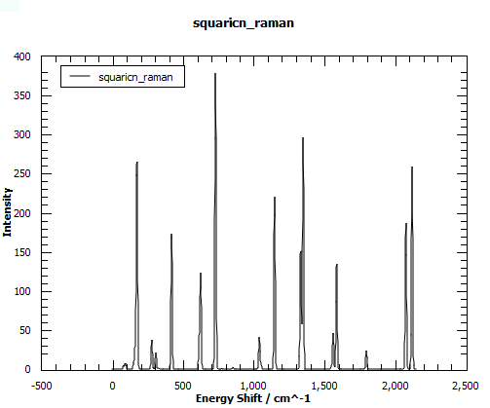
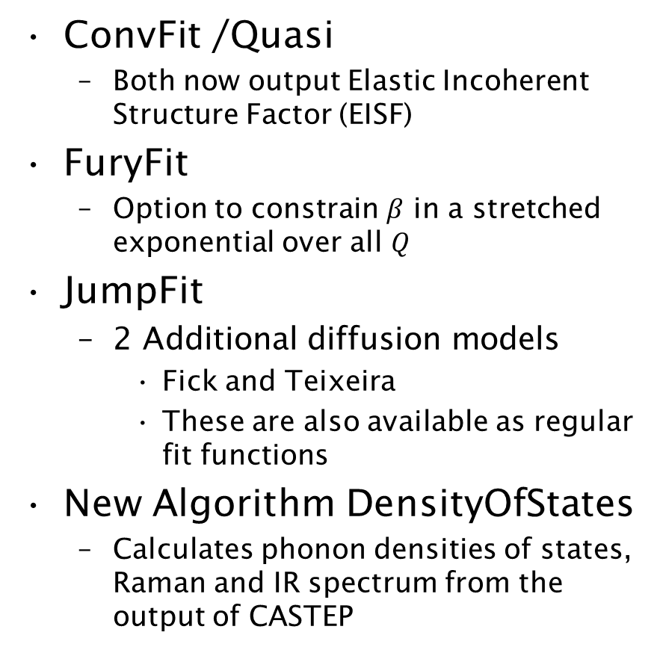
Indirect Inelastic
ConvFit /Quasi
Both now output Elastic Incoherent Structure Factor (EISF)
FuryFit
Option to constrain $β$ in a stretched exponential over all $Q$
JumpFit
2 Additional diffusion models
Fick and Teixeira
These are also available as regular fit functions
New Algorithm DensityOfStates
Calculates phonon densities of states, Raman and IR spectrum from the output of CASTEP

Slide 23
SANS

Slide 24
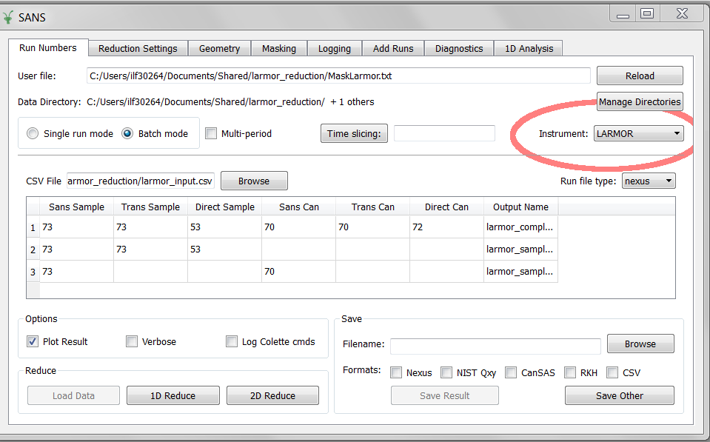
SANS – New Instrument: LARMOR

Slide 25
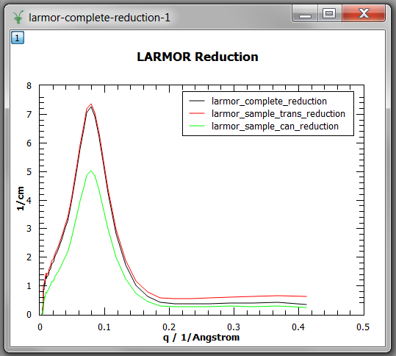
SANS – New Instrument: LARMOR

Slide 26
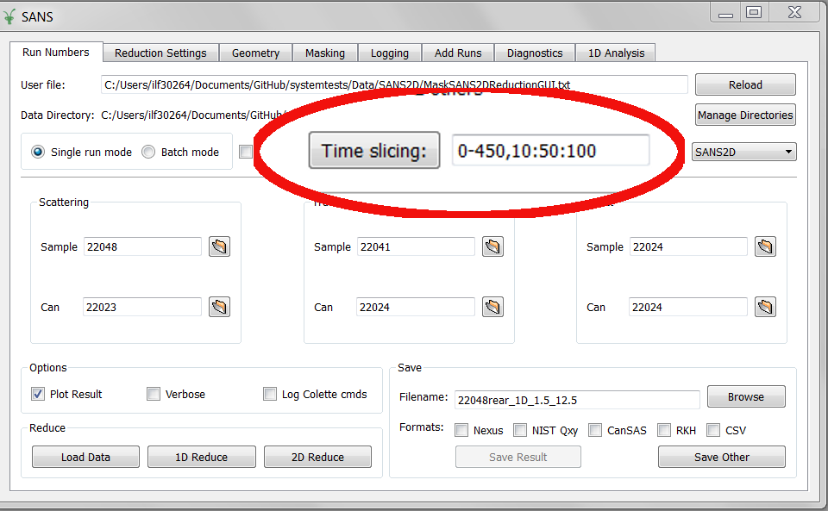
SANS – Slicing Event Mode

Slide 27
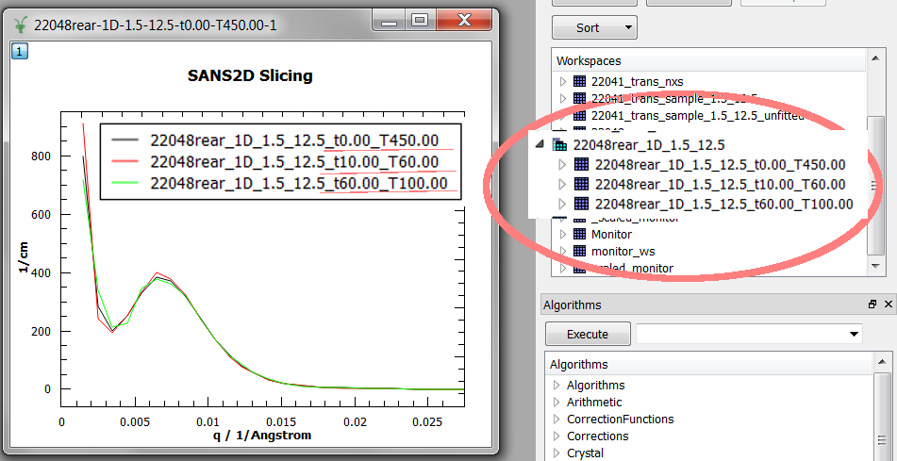
SANS – Slicing Event Mode

Slide 28
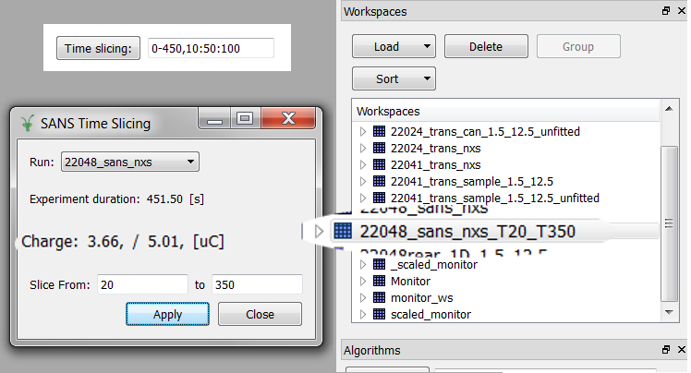
SANS – Slicing Event GUI

Slide 29
SANS – Under the hood
Code Reorganization
Multi-Period data
Robustness to changes
Bug Fixes:
Use the correct monitor to correct background
Search centre use correct transmission for can

Slide 30
Muon

Slide 31
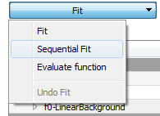
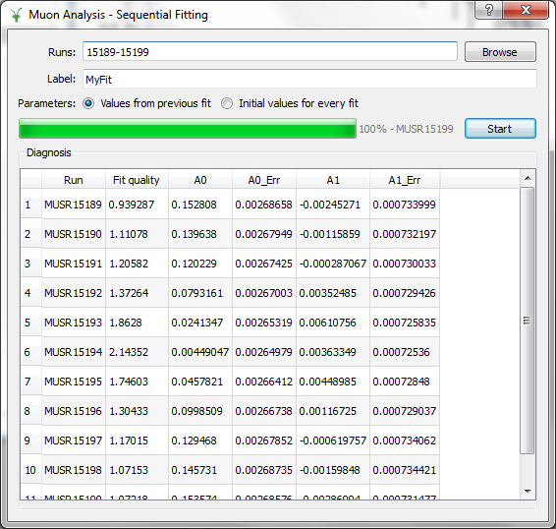
Muon – Sequential fitting

Slide 32
Muon – Workflow
New workflow algorithms
MuonCalculateAsymmetry
MuonLoad
Data structure for grouping
Returned from LoadMuonNexus
MuonGroupDetectors
LoadMuonNexus returns dead times as a table

Slide 33
Muon – Various improvements
Plot positioning
Re-using plot window
More run information parameters read
Sample temperature
Sample magnetic field
Bugfixes
Mostly plotting issues

Slide 34
Reflectometry

Slide 35
Python Scripting ‘Quick’
Fix instrument orientation issues in position correction calculations
Remove all mandatory IDF dependencies quick_explicit
Made it possible to pass in stitching parameters and arbitrary normalisation functions.
Better naming and auxiliary workspace clean-up post-processing
IDF Parameter updates for CRISP, SURF, INTER and POLREF. Brand new parameter files in some cases.

Slide 36
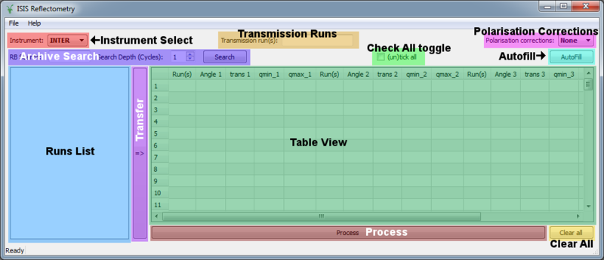
GUI modifications
Port everything to version 2 of python API
Extract out GUI logic and dependencies from the quick scripts. Reverse engineer ui files.
Configurable journal searching
More shortcuts and menu-options
Better online documentation

Slide 37
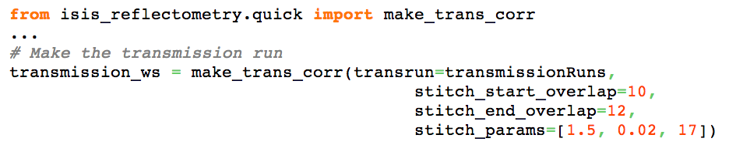
Separation of Transmission Run
make_trans_corr function in quick script
quick and quick_explicit functions can take 0-2 transmission workspaces
Optional ability to pass an exponential or polynomial correction function instead
Can even define your own correction function in python and pass that in.
Examples here http://www.mantidproject.org/Reflectometry_Guide

Slide 38
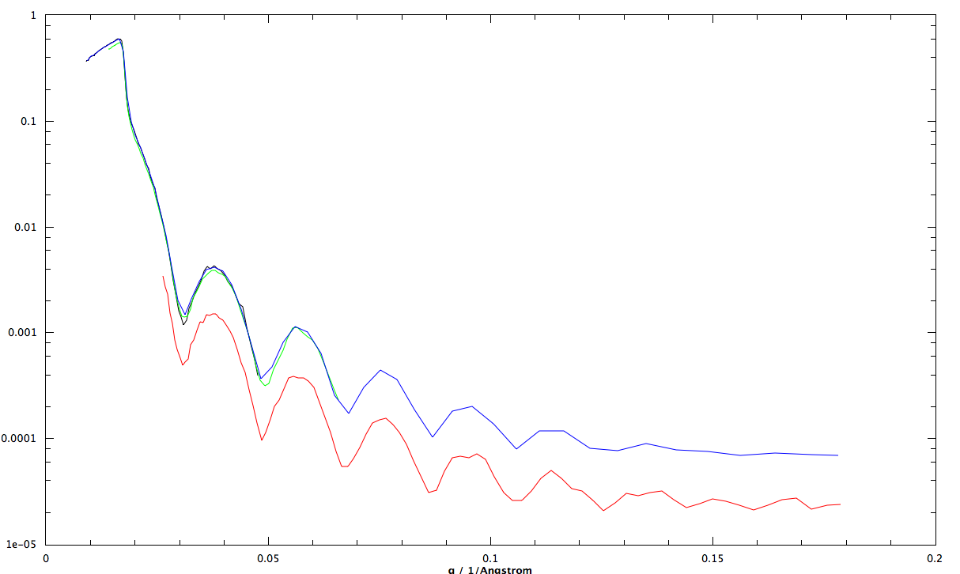
Stitching Fixes
Stitch1D requires LHSWorkspace, RHSWorkspace and step-size Only
Similar fix to Stitch1DMany
All other parameters are optional, and calculated internally if not provided.

Slide 39
Workflow Algorithms
ReflectometryReductionOne, algorithm for quick_explicit
CreateTransmissionWorkspace, algorithm for make_trans_corr
Stricter input checks and more useful outputs
Common, shared code on c++ side
Verified against original python scripts and by instrument scientists.

Slide 40
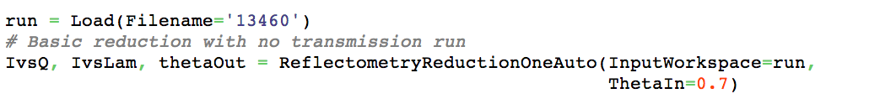
Workflow Algorithms
More recent additions:
ReflectometryReductionOneAuto
CreateTransmissionWorkspaceAuto
Attempt to fetch instrument-specifics from Parameter files, But everything can be explicitly overridden if provided.
More examples: http://www.mantidproject.org/Reflectometry_Guide

Slide 41
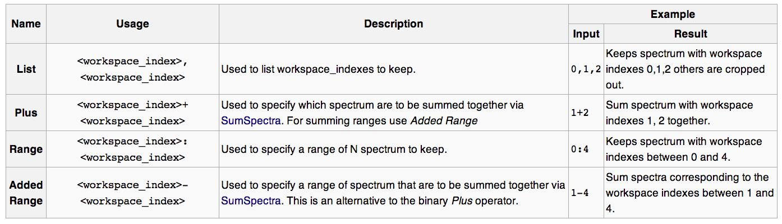
Process Workspace Indexes
PerformIndexOperations - Workspace index analogue for MultiFileLoading
Supports the same syntax
Used by ReflectometryReductionOne for specifying, grouping and summing spectra

Slide 42
Other Improvement
Much wider set of automated regression testing
Workflow testing for multidetector runs and for untested instruments such as SURF
Better online documentation
Road-map, workflow, regular testing, scientist-driven development cycles.

Slide 43
Diffraction

Slide 44
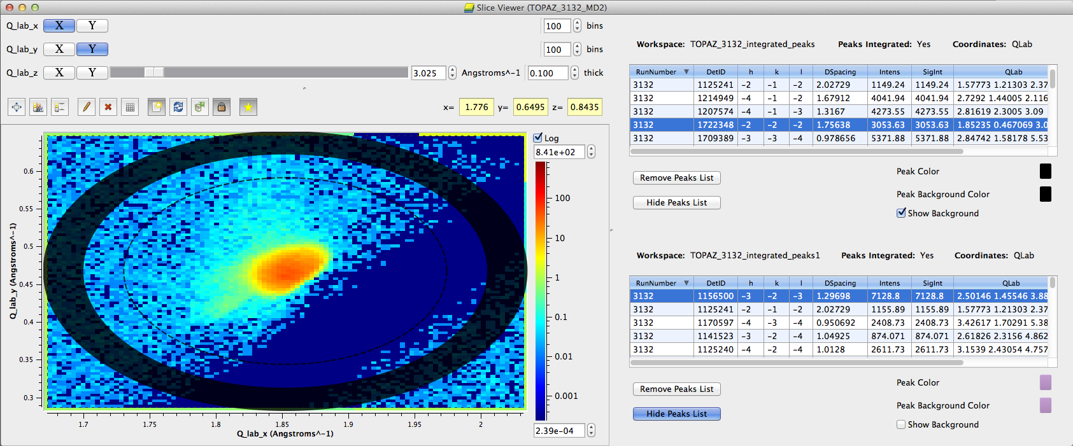
Extended Python Control
Control and plot individual peak workspaces
Control peak colour and background colour
Control hiding/showing the peak list
Control showing background radius
Python control is mirrored in SliceViewer
Documentation and examples: http://www.mantidproject.org/SliceViewer_Python_Interface

Slide 45
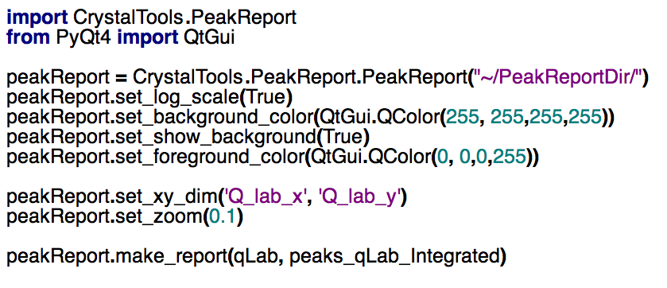
Peak Report

Slide 46
Peak Report

Slide 47
Other Changes
Warn when Integrated peaks overlap in IntegratePeaksMD
LoadISAWPeaks and SaveISAWPeaks work on WISH
SaveISAWUB now works on MDEventWorkspaces
OptimizeLatticeForCellType now allows PerRun optimisation
PeakRadius stored in the PeaksWorkspace and nexus format PeaksWorkspace. Same for BackgroundRadius.

Slide 48
Next Release

Slide 49
What’s coming in v3.2
Planned Release Date: Friday 2nd May 2014
Mantid Roadmap coming soon!
Planned implementations over the next 1-2 years
Covering requirements from
Scientific Steering Committee
Facility scientific computing strategies
Technical changes and updates

Slide 50

Thank you

